Slide 1

IBM Capstone
Project
The Battle of the Neighborhoods
（New York）

Slide 2
1. Description of the Project and Data
2. Methodology
CONCENTS
3. Result And Conclusion
4. Final Discussion

Slide 3
01
Description of the Project and Data
This project tends to solve a problem by applying data science
methods on the location data gotten from FourSquare API

Slide 4
Description of the Project and Data
Data Collection
•Numbers of existing restaurants in the neighborhood (any type of restaurant).
•Number of and distance to dfifferent kinds of restaurants in the neighborhood, like any distance of neighborhood from city center number of school in the neighborhood.
•Data on the neighbourhoods in general, specifically the categories for each venue in each Manhattan neighbourhood.
•Popular days and hours for venues that serve our target customer, a popularity score for each of the target venues.
Introduction
in the project I decide to find what aspects of a neighborhood that can effect the choice of the restaurant.The taste of the food ? The distance between the restaurant and office? Can the venues surrounding an accommodation effect its price so it might me expensive for you to afford? People will choose a better evironment to enjoy the food even though they need to pay more money and wait for more time? All of these need data to prove.

Slide 5
Description of the Project and Data
The Data I collect from:
New-York data set: https://cocl.us/new_york_dataset
One is a free data source from NYU Spatial Data Repository - https://geo.nyu.edu/catalog/nyu_2451_34572. The neighborhood locations will be obtained from here.
Number of restaurants, their type, location and rating will be obtained using Foursquare API and Zomato. https://developer.foursquare.com/

Slide 6
02
Methodology

Slide 7
Methodology
Let's create latitude & longitude coordinates for centroids of our candidate neighborhoods. We will create a grid of cells covering our area of interest which is aprox. 12x12 killometers centered around Berlin city center.
After extraction, we dive into exploring the data. We use the PCA method to reduce dimensions and analyze the two main components KDE information. Finaly, we use the KMeans method and Silhoutte metric to create the cluster. Caution, we preprocessing the feature Distance from center by StandardScaler method.
The NYU data source contains location information for all 5 NYC boroughs and 306 neighborhoods. Since we already know which neighborhoods we want to focus on we can simplify our data source from here.

Slide 8
03
Result And Conclusion

Slide 9
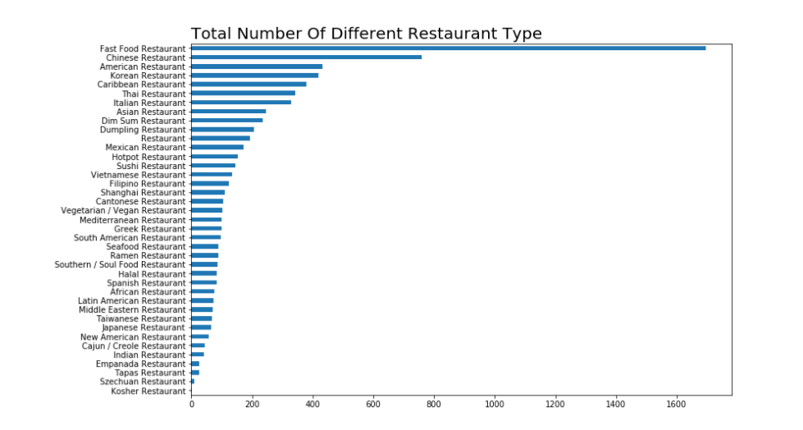
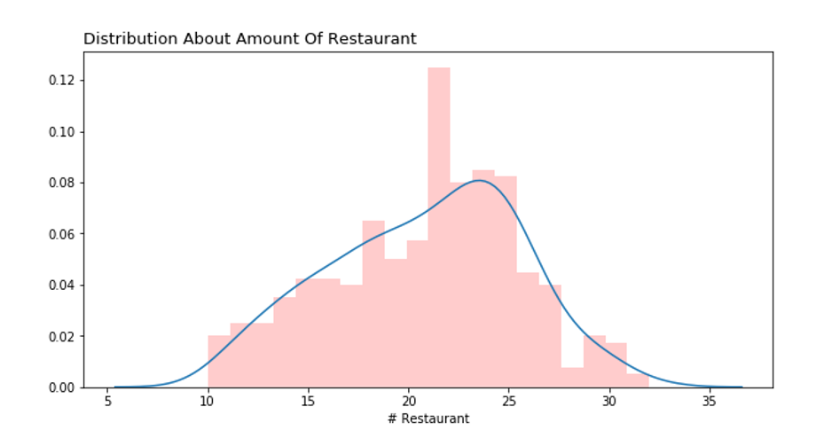
Result And Conclusion
We can explore the cluster information, so that we can get the initial conclusion.

Slide 10
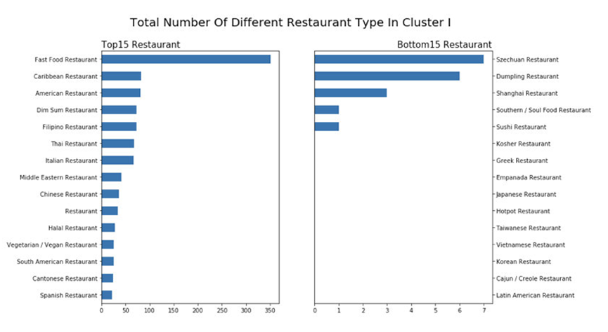
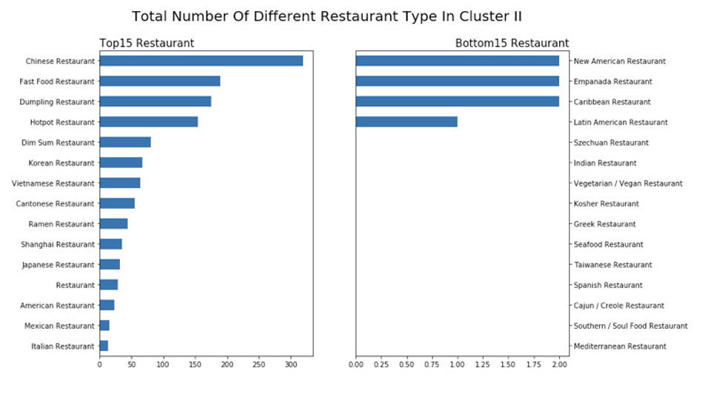
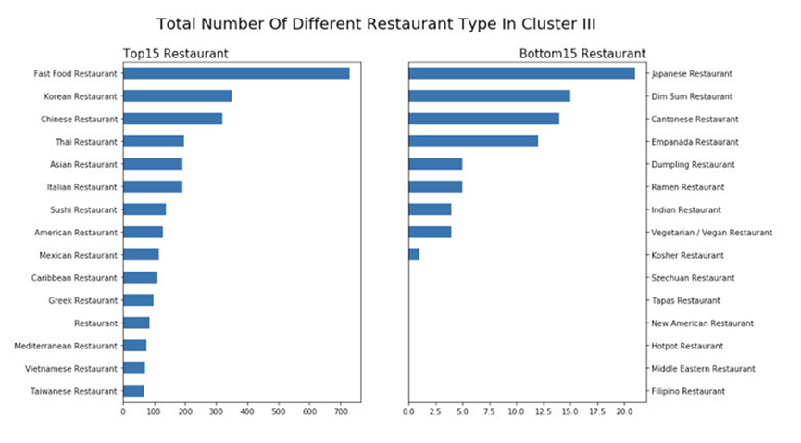
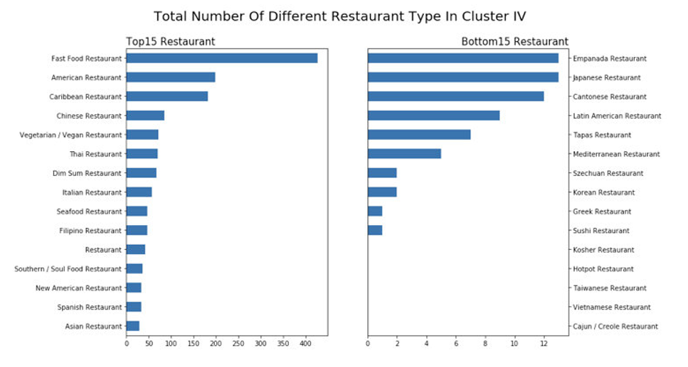
Result And Conclusion

Slide 11
Result And Conclusion
Cluster 2
Chinese Restaurant is main type
Asian Restaurants have the largest market, like Chinese Breakfast restaurant
Western Restaurants have the few market
Cluster 1
Fast Restaurant is main type
Western Restaurants have the largest market
Eastern Restaurants have the few market
Cluster 3
Fast Food Restaurant is main type.
Asian Restaurants and western restaurant are same important type the Asian restaurant is lack of variety.
The candidate location is a good choice to open an Asian restaurant.
Cluster 4
Fast Food Restaurant is main type.
The candidate location has mixture restaurant type.
Asian Restaurants and western restaurant are same important type the Asian restaurant is lack of variety.

Slide 12
04
Final Discussion

Slide 13
Final Discussion
1. We can make a choice that choose the appropriate restaurant type at appropriate candidate location. Like that the Chinese Breakfast restaurant is good choice at Cluster III candidate location.
2. Our analysis shows that although there is a great number of restaurants in New York City (~2000 in our initial area of interest which was 12x12km around Queens), the fast food restaurant is main type close to city center. The eastern Queens has much more food restaurant than the western Queens center, while the school is opposite. So, if we want to choose a appropriate location to open a new restaurant, we choose from the target.

Slide 14
THANK YOU
2019

